Slide 1
Overlay DC June Webinar for AMER & EMEA
Contrail vRouter DPDK performance update
Przemysław Grygiel
Principal SW Engineer

Slide 2
Agenda
Most recent study on vRouter DPDK and performance improvements
Standardized testing approach
OVS comparison
Performance on AMD Epyc

Slide 3
vRouter
R2003/2005

Slide 4
Contrail 2003 release performance improvements
Kernel core isolation support (vRouter isolating service and control threads)
Ability to increase intercore ring buffer descriptor size
Yield can now be disabled (during long zero loss test cases it can cause packet drops!)

Slide 5
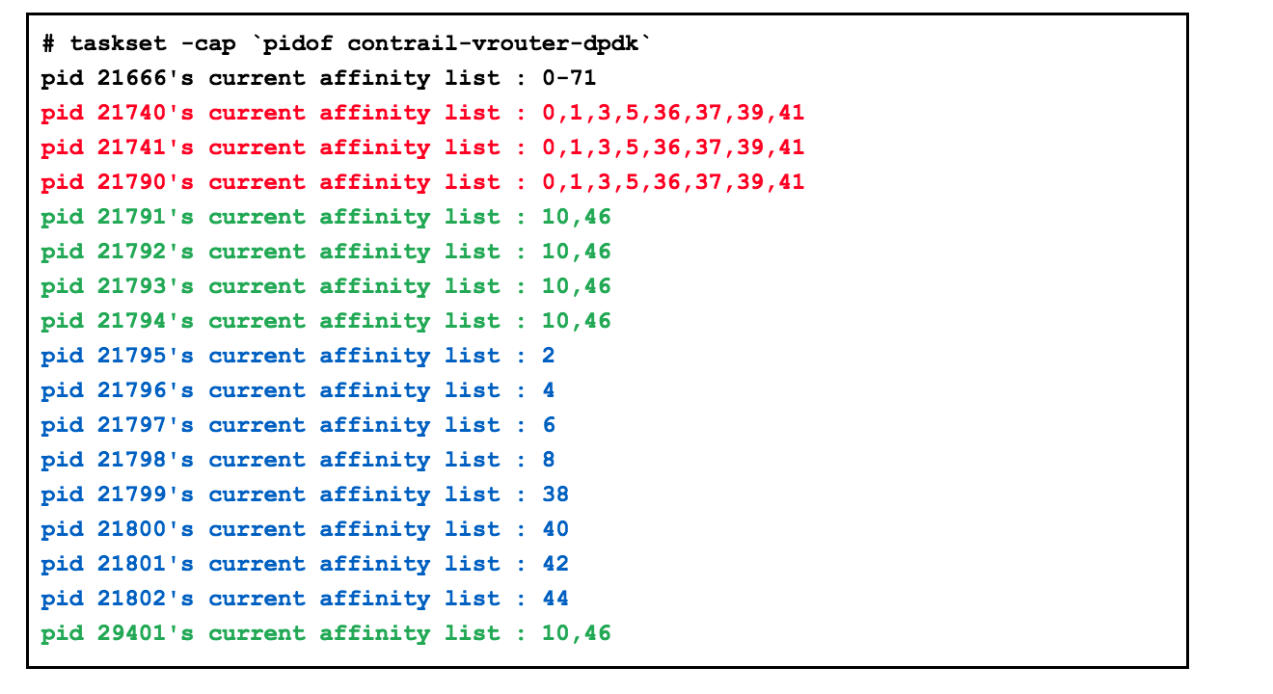
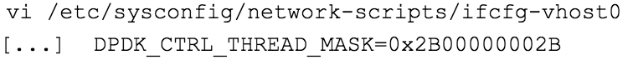
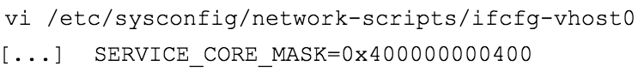
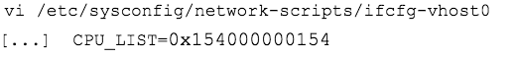
Kernel core isolation support
DPDK VNFs uses Poll Mode Driver (PMD) as well as vRouter. We need to protect PMD against context switching (both vRouter and VNFs).
RedHat suggested using tuned cpu-partitioning profile which will protect all cores against Operating System CPU stealing.
Unfortunately it is not true in some cases. Still some OS processes can be scheduled on VNFs or vRouter cores.
Only kernel isolcpus parameter can forbid kernel scheduler to use given cores.
Challenge!!!
Enabling kernel isolcpu without proper management of vRouter DPDK threads causes a lot of context switching among vRouter DPDK threads.
Control threads
Service threads
Forwarding threads
Source:
CEM-10093
https://docs.google.com/presentation/d/1UDzqtLgRKDO3azQS7VVsMF-y0WMJu6BLe24i_VudyMs/edit#slide=id.g75c8716119_0_0

Slide 6
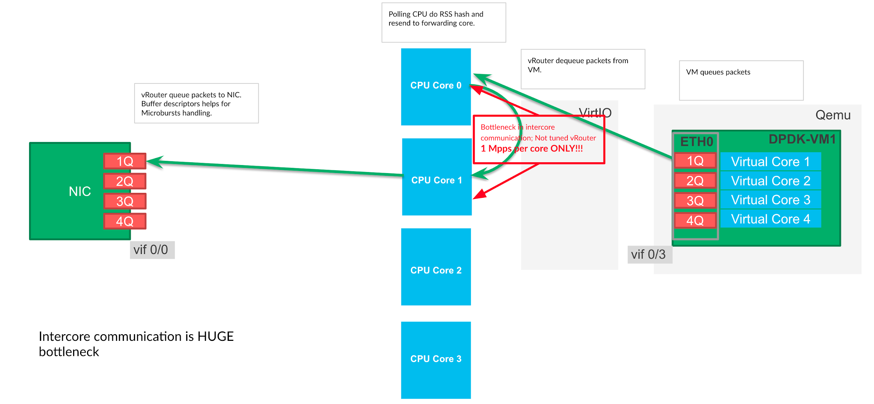
Increase intercore buffer descriptor size (optionally)
Drops due lack of buffer descriptors
Intercore communication buffer descriptors size > 1024 helps handle micro bursts and mitigate slow packet processing by “processing cores”
vr_dpdk_rx_ring_sz
vr_dpdk_tx_ring_sz
Recommended values: 2048 or 4096
To high can increase latency

Slide 7
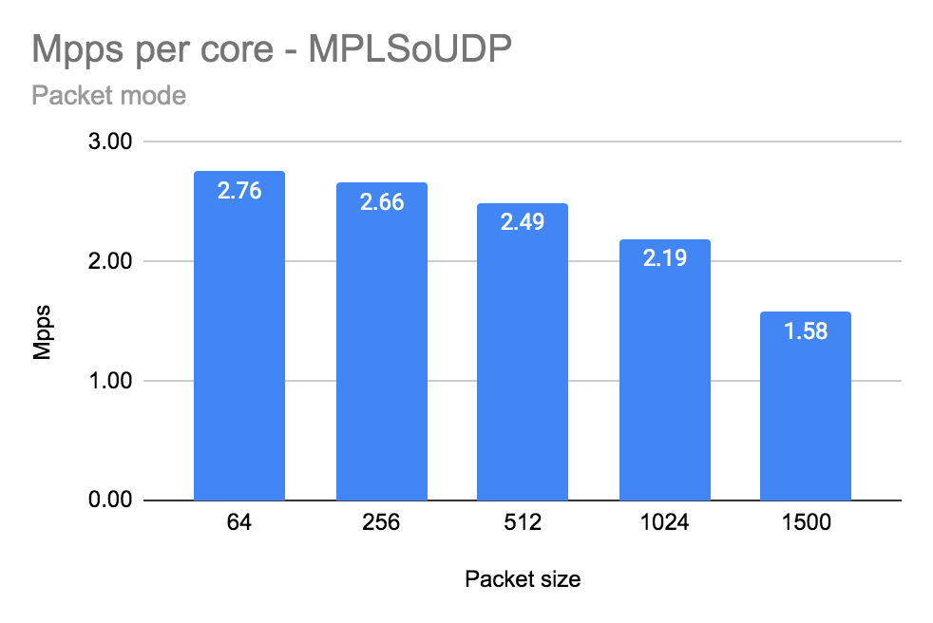
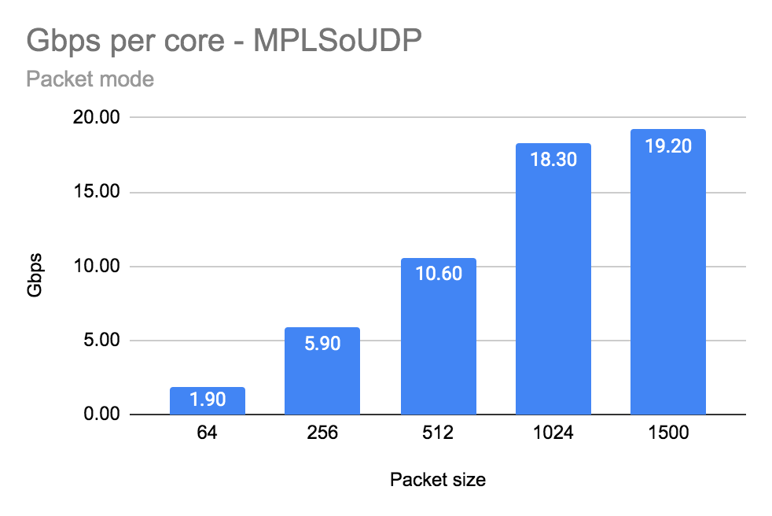
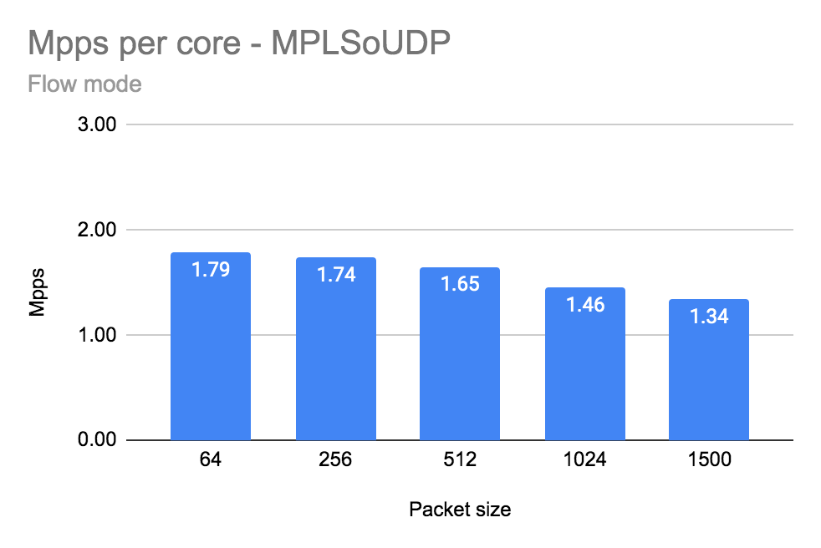
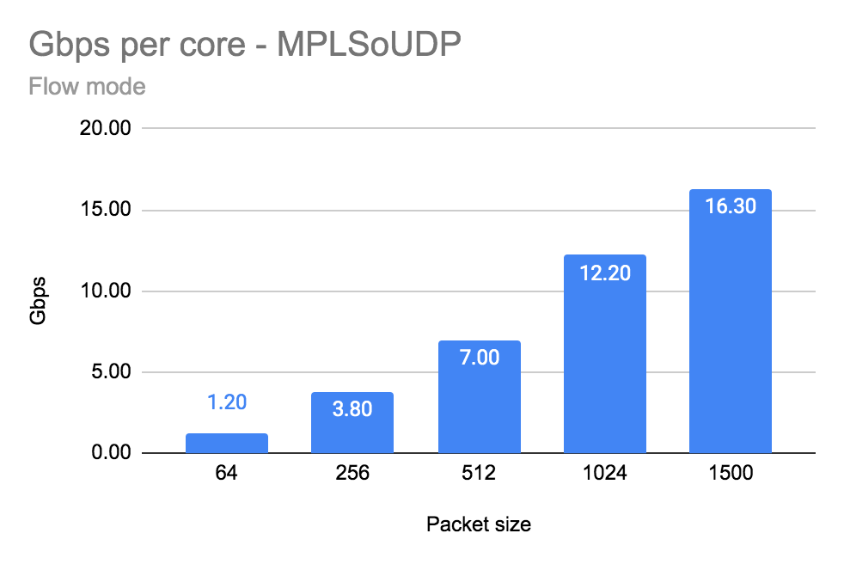
2003 performance results - Intel x710 base
Number of Forwarding Cores | 2 (Physical) + 2 (Siblings)
Drop Rate | 0.001%
Bond | 2 x 10G (802.3ad LACP) with L3/L4 hash
Hugepages | 1G
NUMA allocation | vRouter, NIC and VM on the same socket (NUMA 0)
Number of flows | 16535
Other nics tested as well:
XXV710
Intel x520
Mellanox xConnect4*
Source: https://docs.google.com/document/d/1HxtCnBAfwpvLND8tNeCbZVhrufjnl1ycTzgEVUGMgF0/edit#

Slide 8
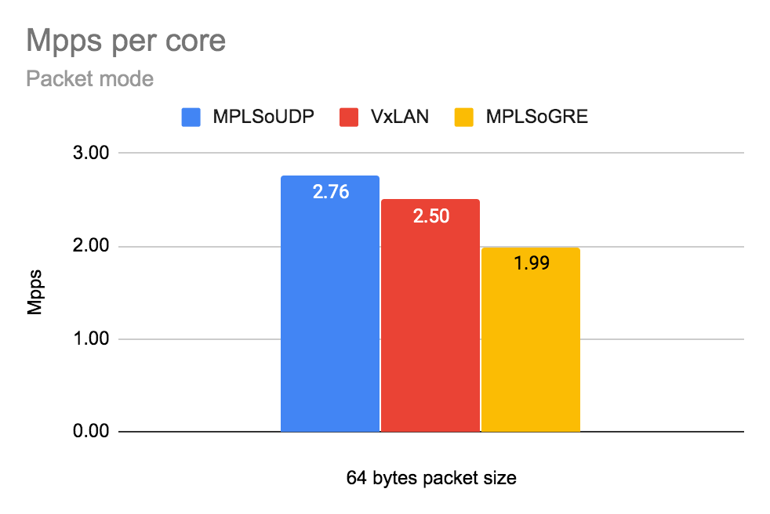
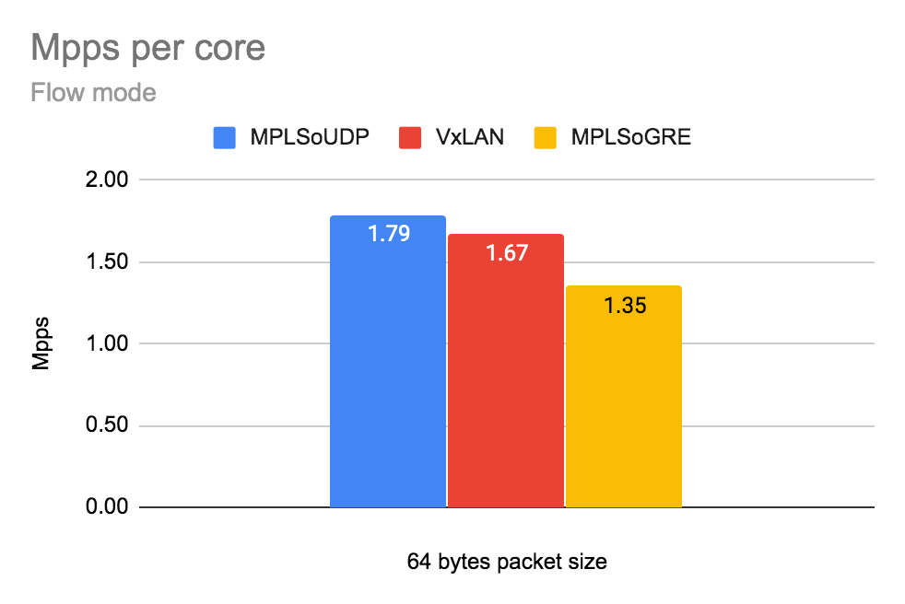
Encapsulation matter
MPLSoGRE will be fixed in 2008 for Intel x710 NICs
*16k Flows, 64 bytes packet size

Slide 9
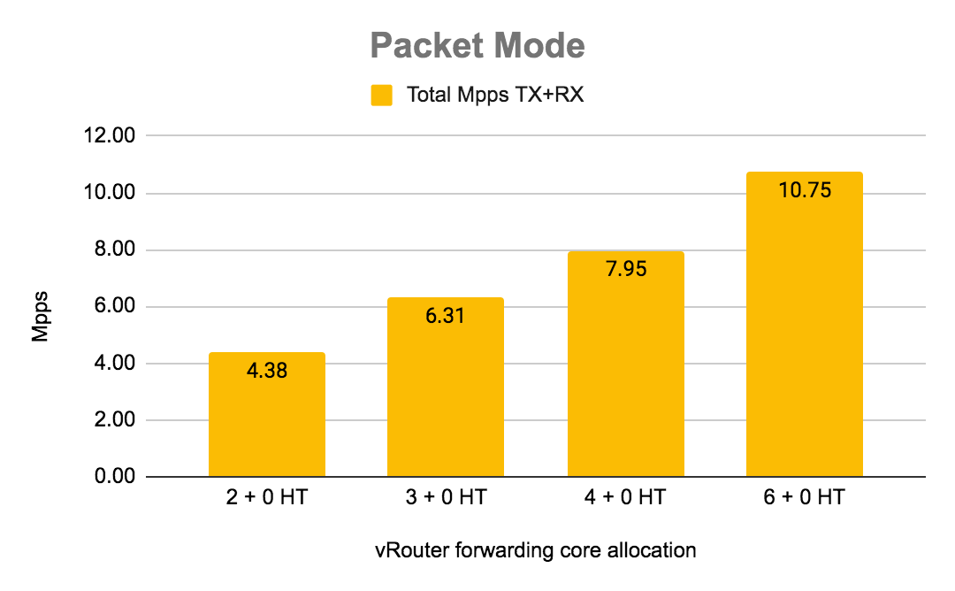
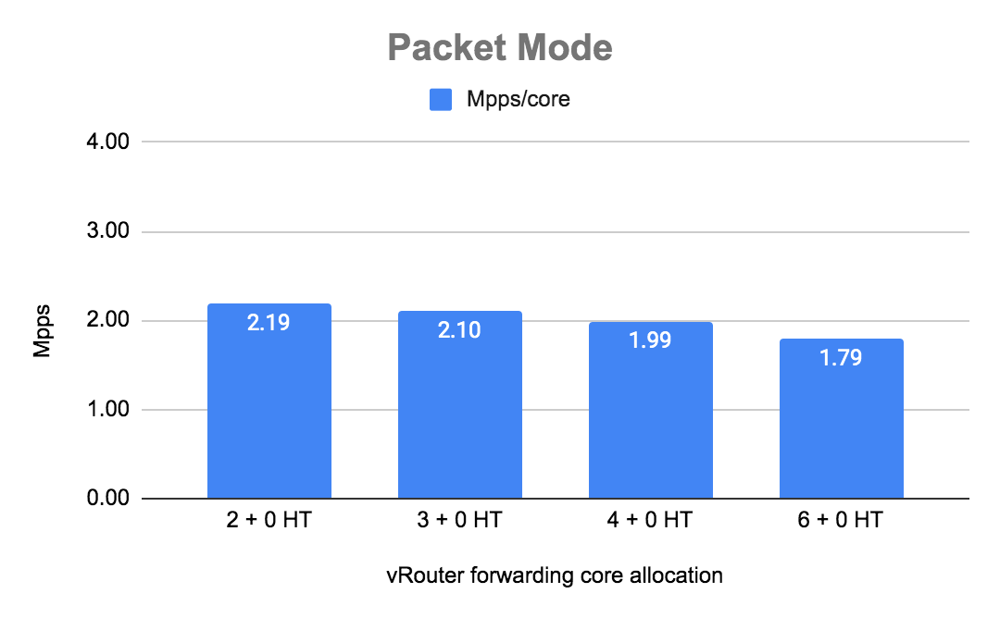
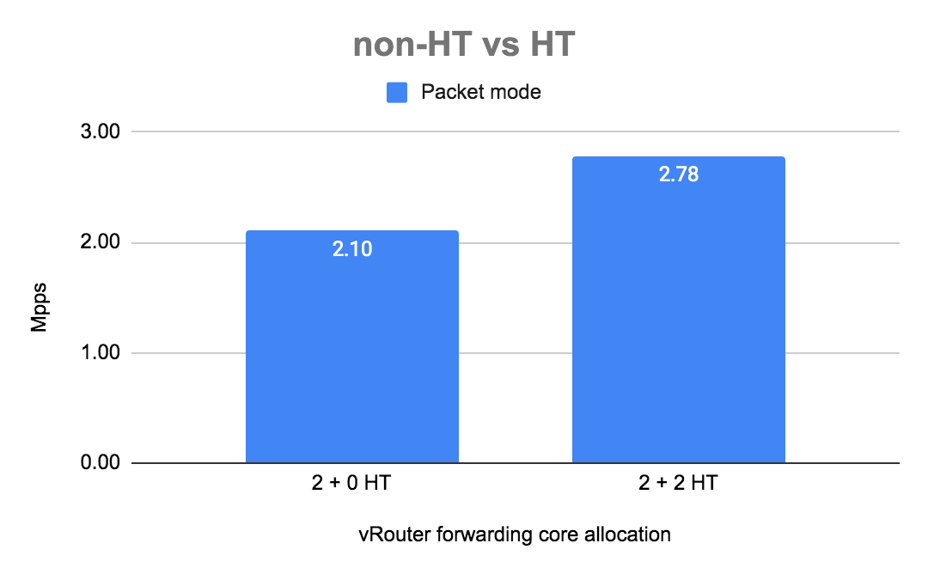
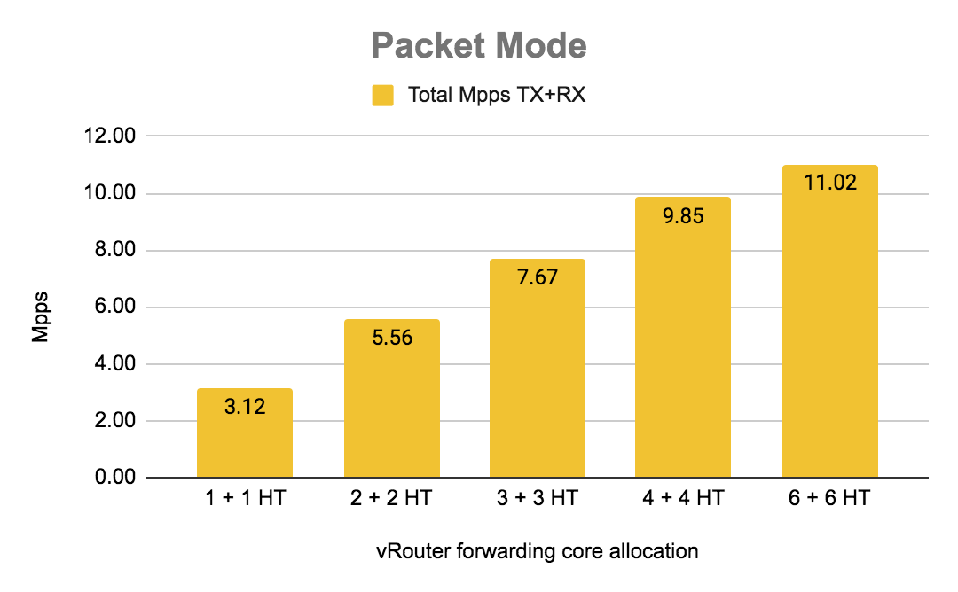
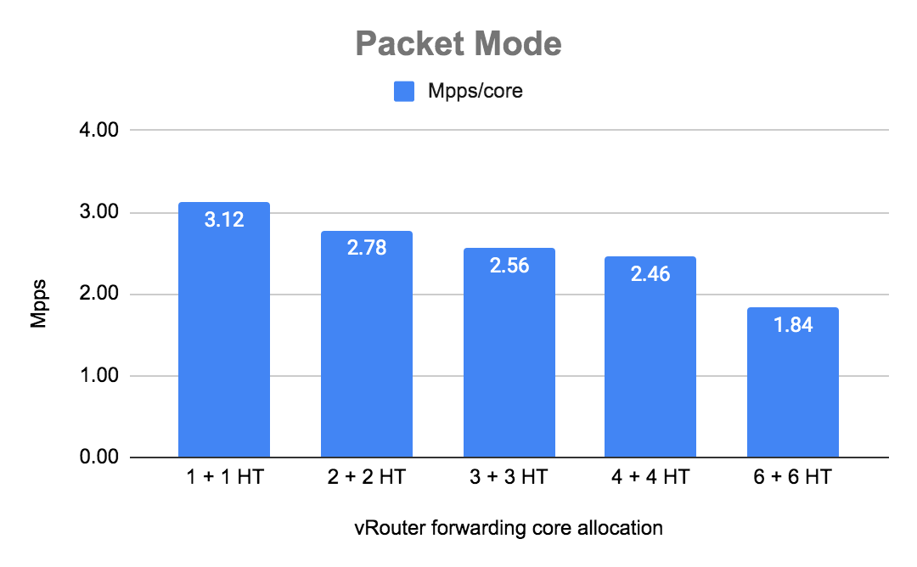
Increasing number of vRouter cores - Packet mode
Using HT siblings yields ~25-30% gain
Adding cores does not increase vrouter performance lineary!

Slide 10
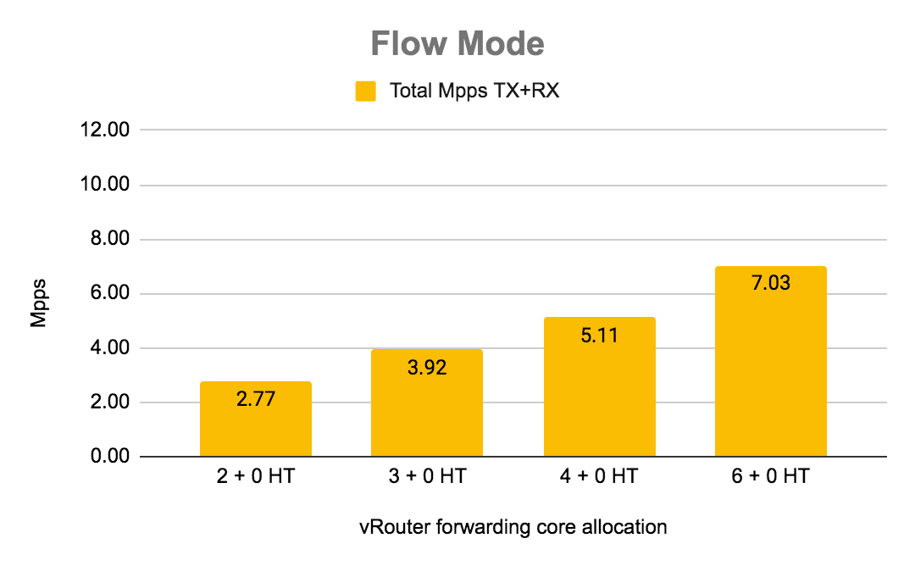
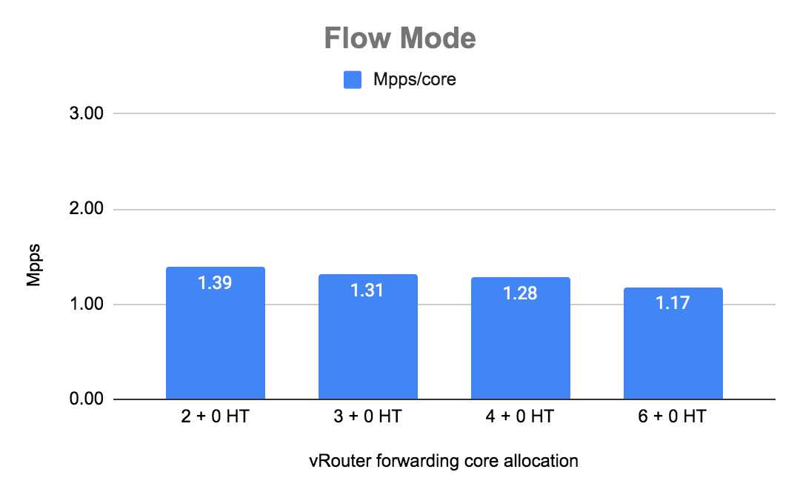
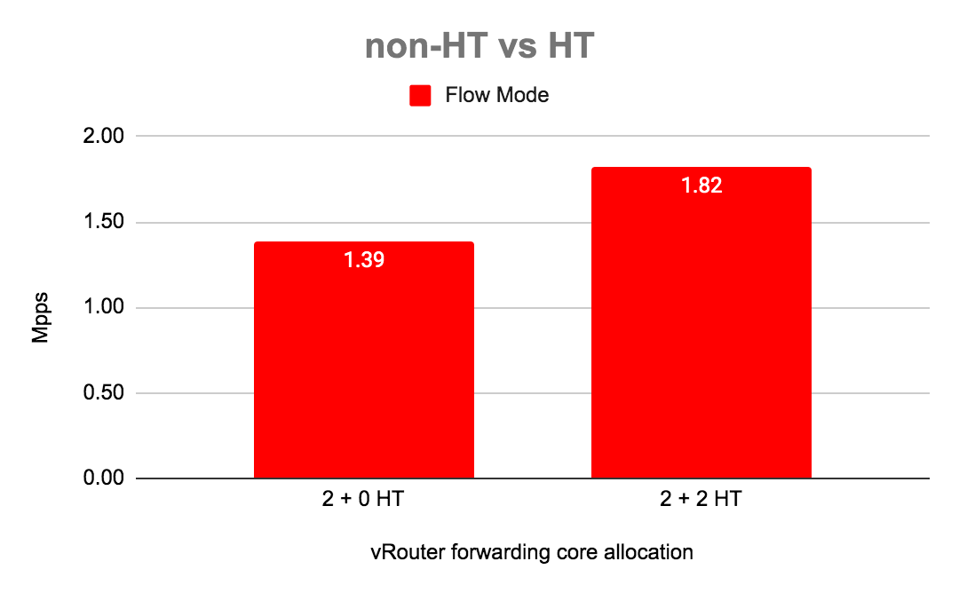
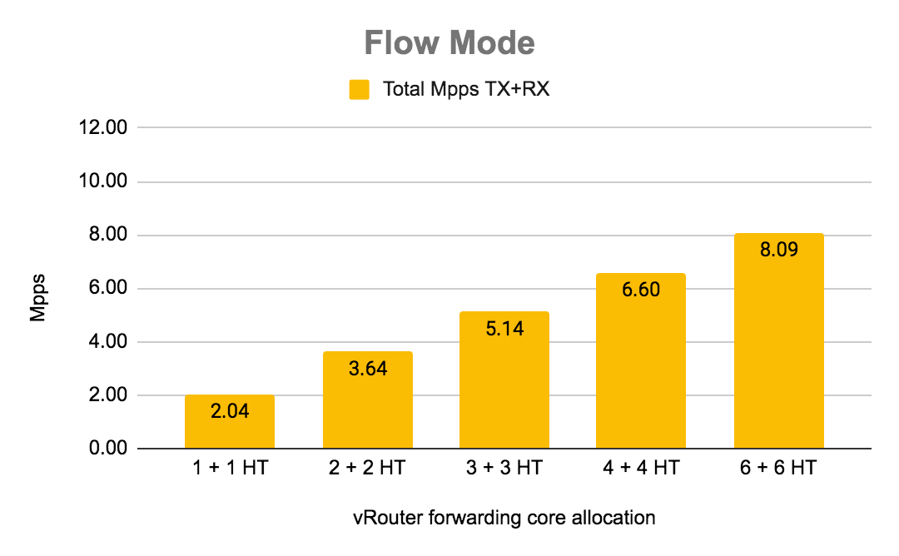
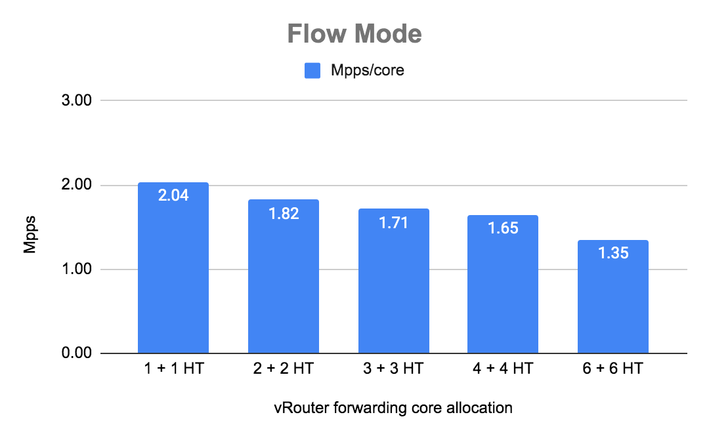
Increasing number of vRouter cores - Flow mode
Using HT siblings yields ~25-30% gain
Adding cores does not increase vrouter performance lineary!

Slide 11
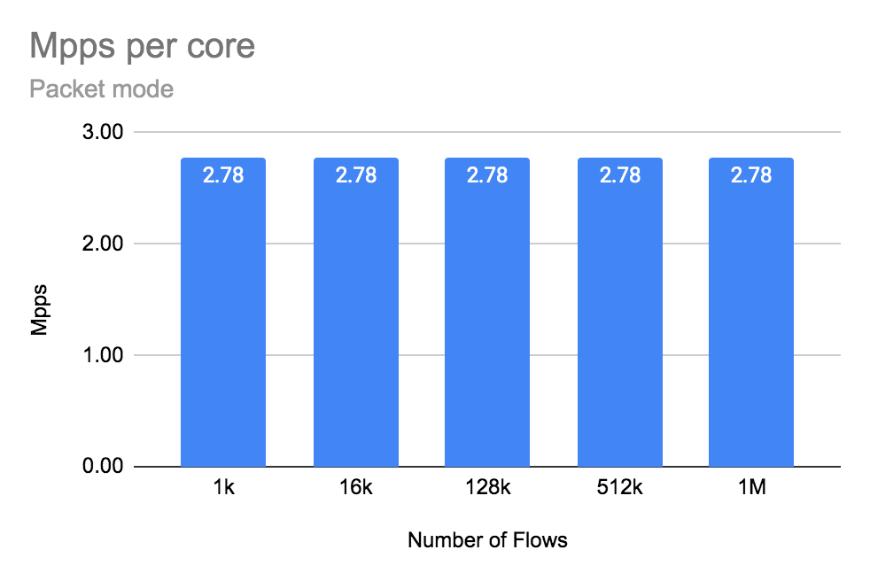
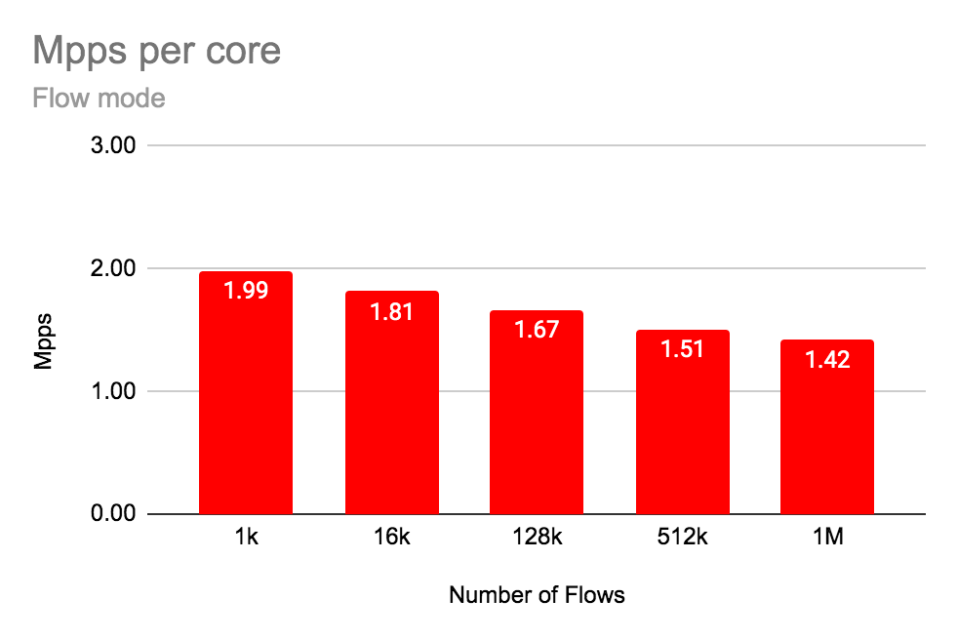
Increasing number of flows
Packet mode is not affected by number of flows

Slide 12
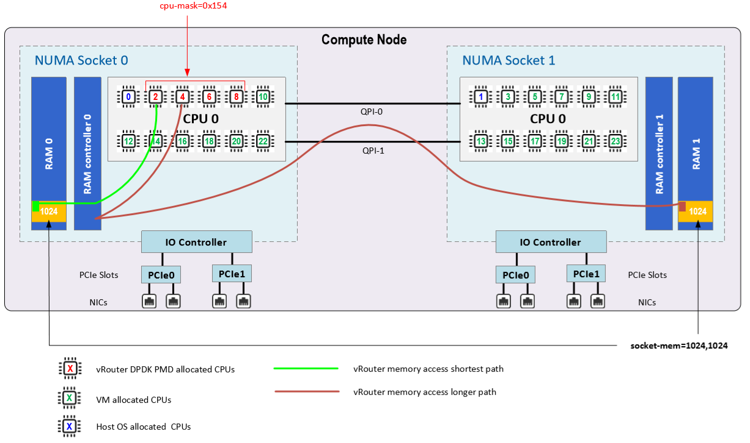
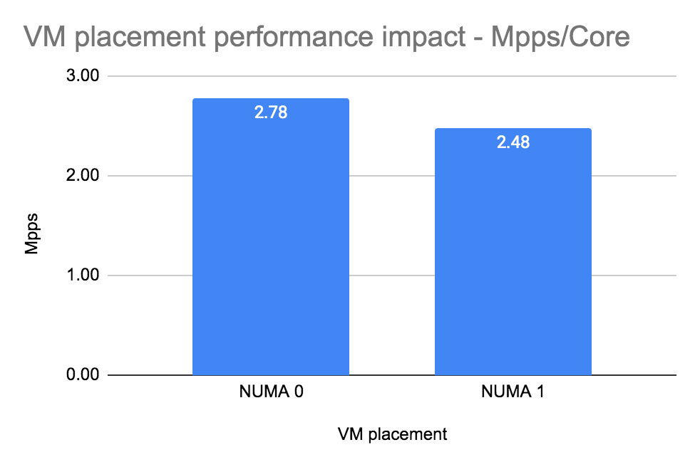
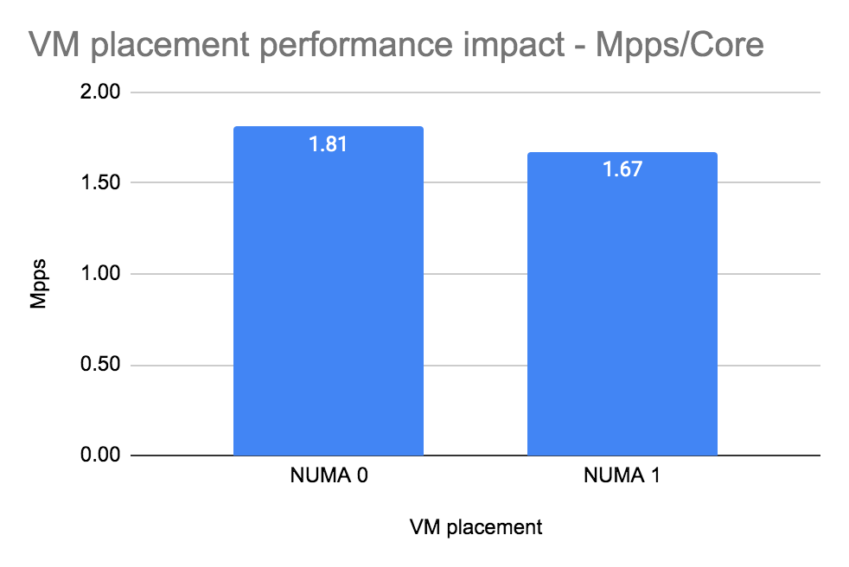
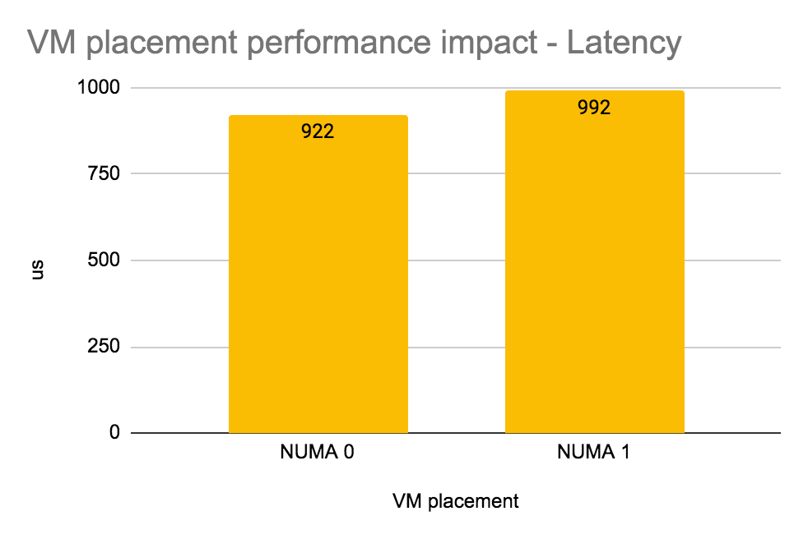
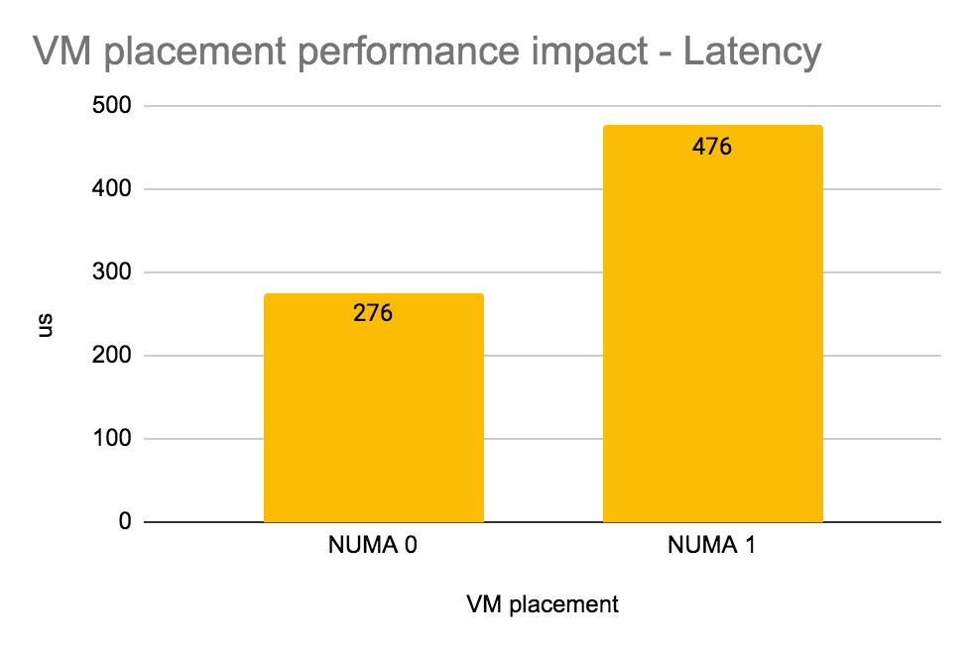
Different NUMA placement for VM
Packet mode
Flow mode
Once VM (VNF) is in different NUMA overall performance decreases ~10%
Latency increases drastically in flow mode ~ 40%.
In packet mode latency degradation is not that significant but still is high near threshold load on vRouter.

Slide 13
vRouter Improvements
what next?

Slide 14
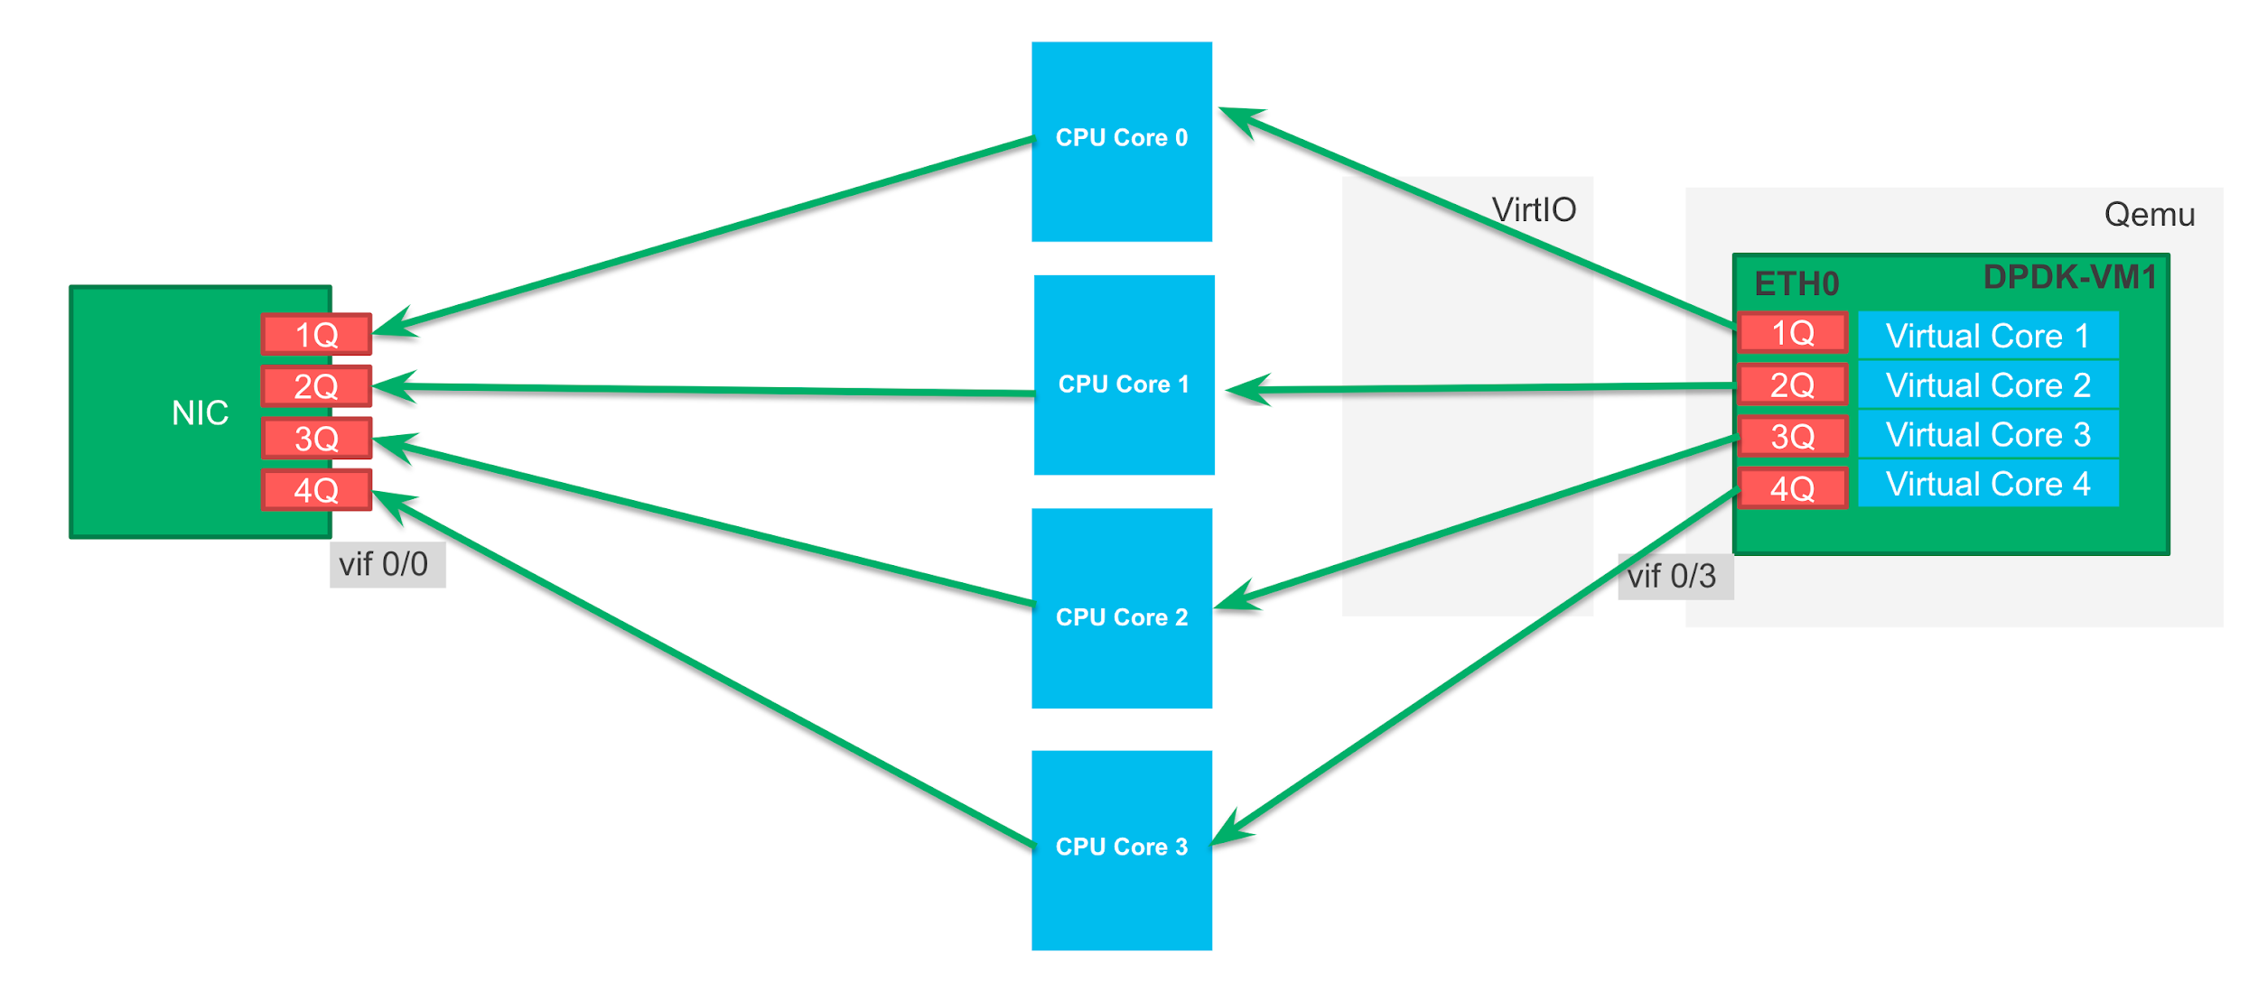
What next?
Intel FPGA SmartNIC
XDP
DPDK
Use DPDK 19.11 (LTS)
Use DPDK virtio instead of one developed in house ages ago
Implement DDP support for Intel x710 NICs (better support of MPLSoGRE hashing) https://contrail-jws.atlassian.net/browse/CEM-14749
Micro benchmarking to identify potential bottlenecks
Disable intercore communication to reduce latency and increase pps (specification and prototype done)

Slide 15
Standardized testing approach

Slide 16
VM to VM traffic with overlay (compute to compute)
Bare metal
Compute A
Compute B
LACP Bond
20Gbps
LACP Bond
20Gbps
Prox
generate
VM
Prox
looping
VM
eth0
NIC1
Switching fabric
Spine and leaf
NIC1
eth0
vRouter
vRouter
eth1
NIC2
NIC2
eth1
Rapid jump VM
Control traffic only
eth1
Test traffic
Control traffic
Compute C

Slide 17
Test tool introduction
Rapid and Prox
Rapid is a wrapper around Prox to run tests and collect results.
Rapid wiki https://wiki.opnfv.org/display/SAM/Rapid+scripting
To deploy that we use Heat
Deployment of Rapid on Contrail environment https://github.com/damjanek/dpdk-prox-contrail
Deployment of Rapid on OVS environment https://github.com/damjanek/dpdk-prox-ovs
We test the performance with overlay (MPLSoUDP, VxLAN and MPLSoGRE) as do all our Contrail customers.
For best results we use multiqueue.

Slide 18
New testing methodology test cases
Test case 1: Number of packets per second (Mpps) and Throughput (Gbps) per core on Intel 82599 Niantic Ethernet Adapters
Test case 2: Number of packets per second (Mpps) and Throughput (Gbps) per core on Intel X710 Fortville Ethernet Adapters + low latency
Test case 3: Number of packets per second (Mpps) and Throughput (Gbps) per core on Intel XXV710 Ethernet Adapters
Test case 4: Compare NICs results Intel 82599 vs Intel X710 vs Intel XXV710
Test case 5: Number of packets per second (Mpps) and Throughput (Gbps) per core with increasing number of vRouter cores
Test case 6: Number of packets per second (Mpps) per core with increasing number of flows
Test case 7: Packets per second (Mpps) with different NUMA placement for VM
Test case 8: Number of packets per second (Mpps) per core with different HugePage sizes
The new performance report: https://docs.google.com/document/d/1HxtCnBAfwpvLND8tNeCbZVhrufjnl1ycTzgEVUGMgF0/edit#heading=h.pidnjoen245s

Slide 19
DPDK tests DIY
Guide how to run testing the framework
Configure high performance Contrail Cloud computes
Configure high performance Contrail Networking on computes with TripleO heat templates

Slide 20
OVS comparison

Slide 21
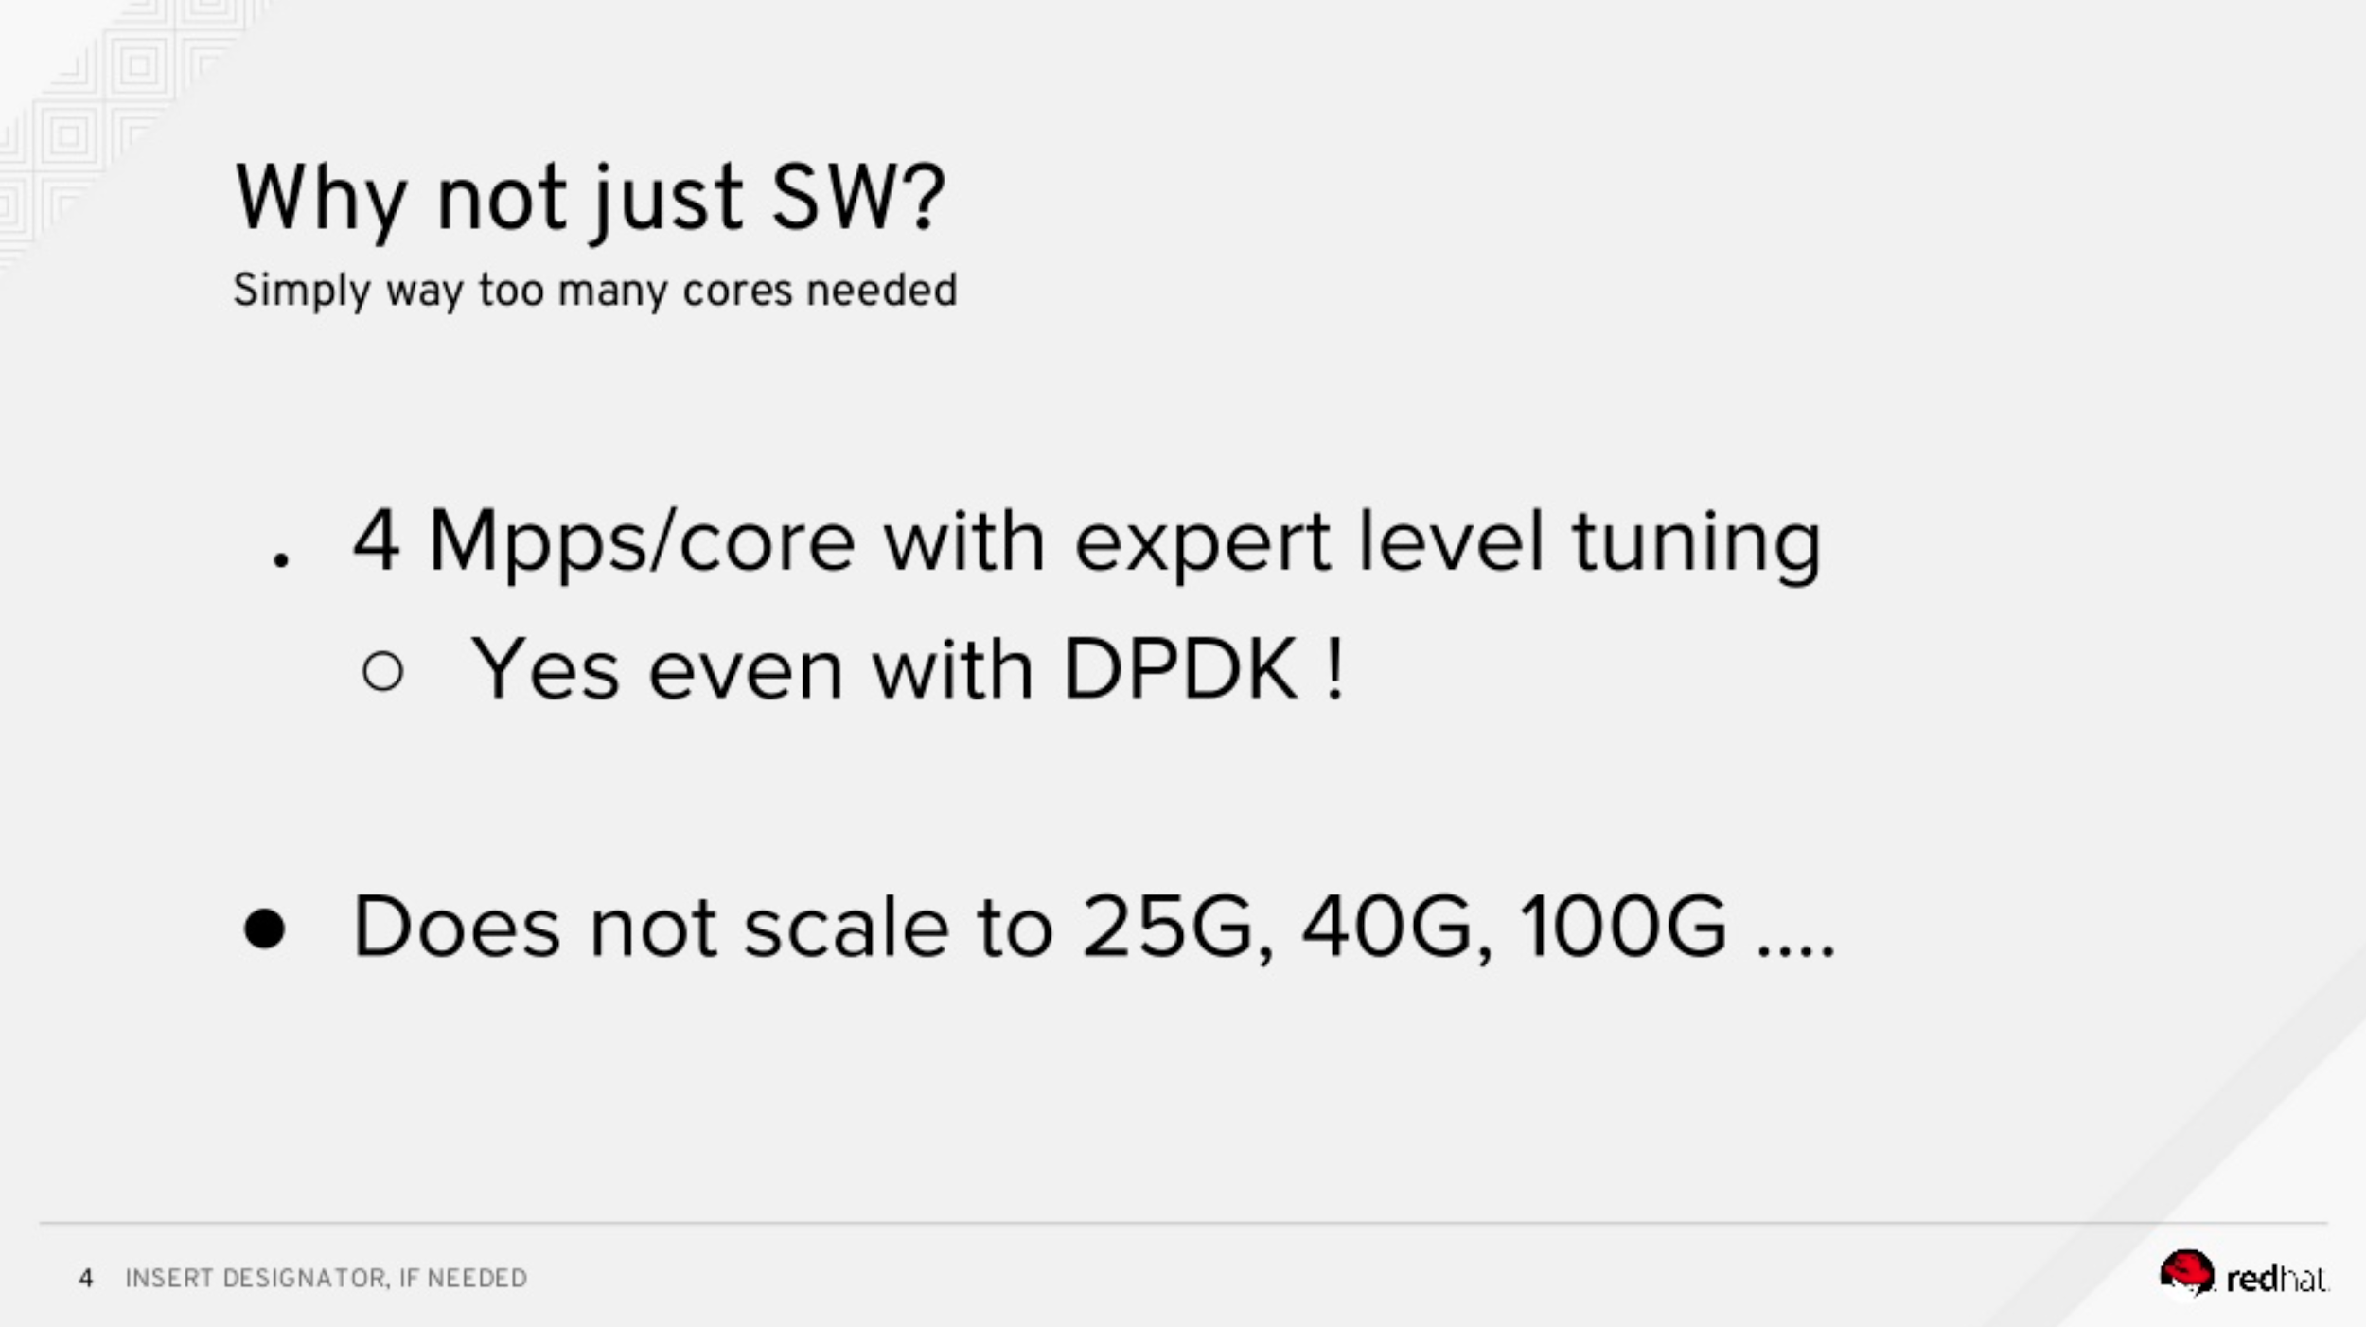
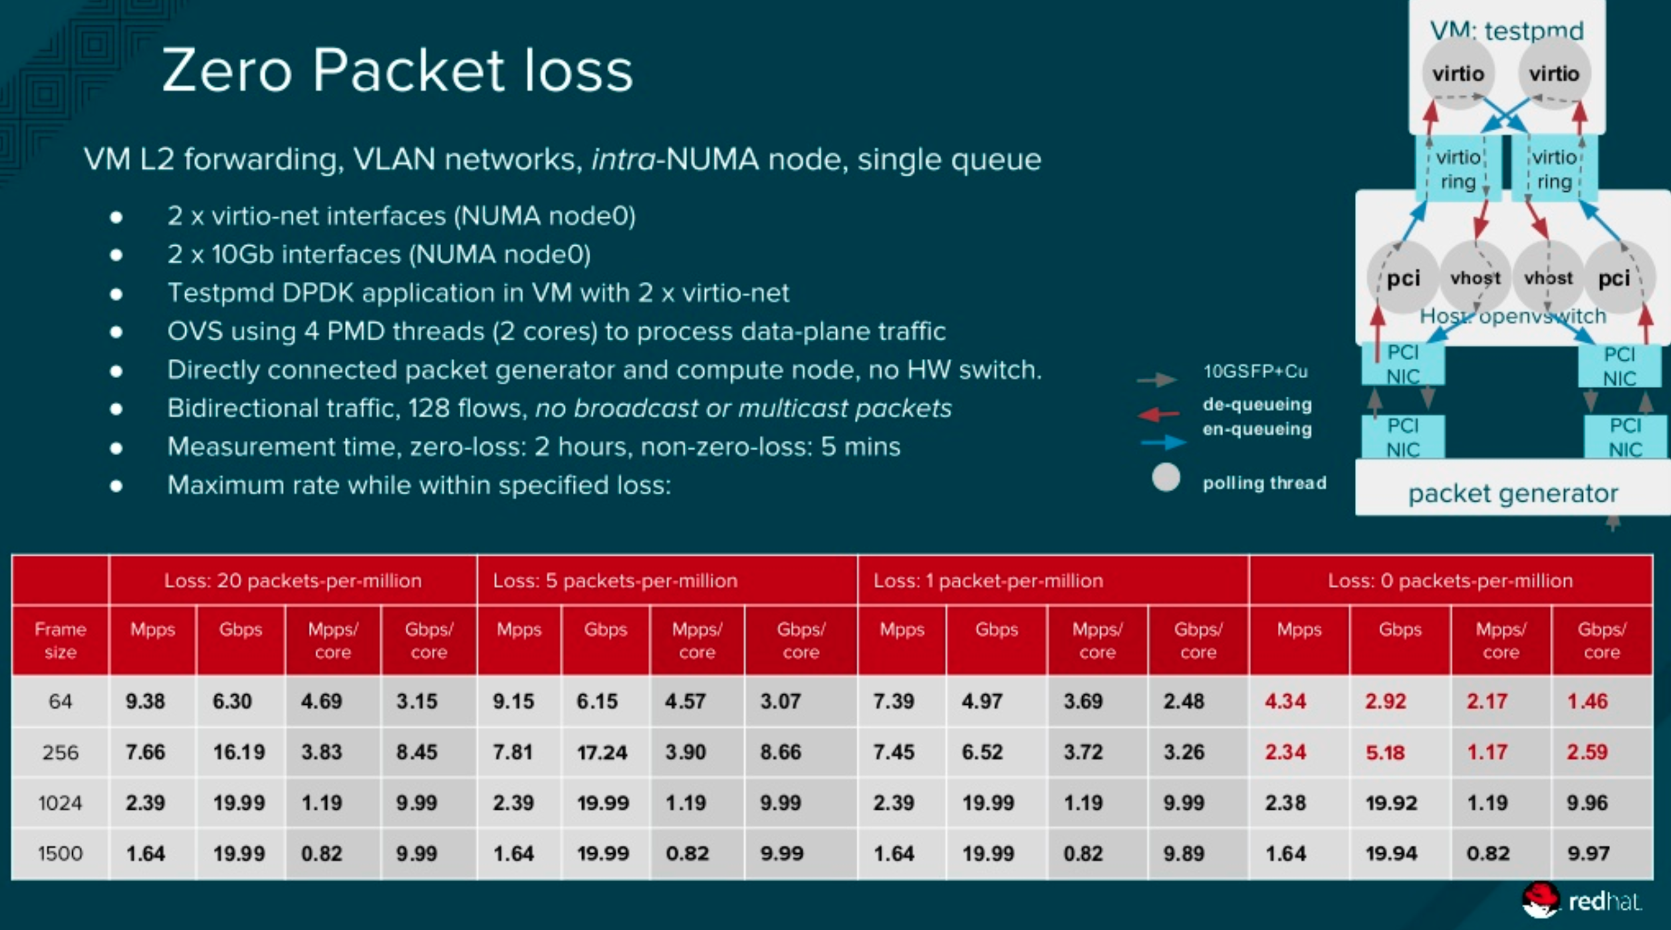
What we see on the OVS performance presentation
source: https://www.slideshare.net/LF_OpenvSwitch/lfovs17red-hats-perspective-on-ovs-hw-offload-status

Slide 22
What we DON’T see on the OVS performance presentation
#3
The best case - 2 physical cores only
#2
Only 128 flows
#1
Physical - VM - Physical
NO Overlay !!!
source: https://www.slideshare.net/LF_OpenvSwitch/lfovs17red-hats-perspective-on-ovs-hw-offload-status

Slide 23
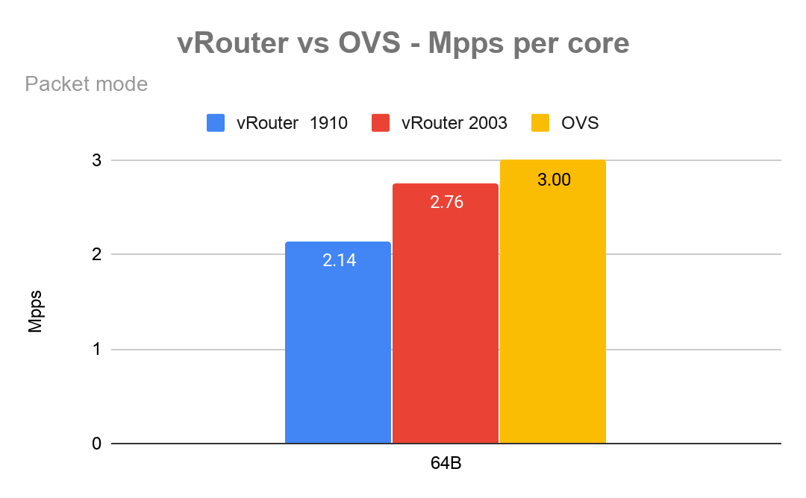
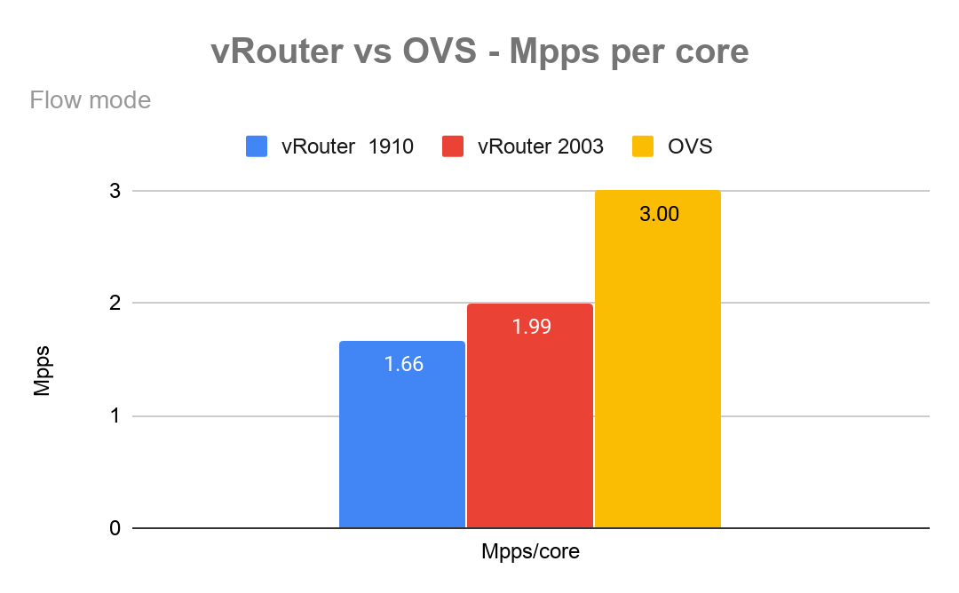
#1
Test the OVS with overlay
Packet size | 64B |  |  |  |  | 256B |  |  |  |  | 512B |  |  |  |  | 1024B |  |  |  |  | 1500B
OVS | Mpps |  | Gbps |  | Lat. avg | Mpps |  | Gbps |  | Lat. avg | Mpps |  | Gbps |  | Lat. avg | Mpps |  | Gbps |  | Lat. avg | Mpps |  | Gbps |  | Lat. avg
Drop rate | Total | Per core | Total | Per core | us | Total | Per core | Total | Per core | us | Total | Per core | Total | Per core | us | Total | Per core | Total | Per core | us | Total | Per core | Total | Per core | us
0.01% | 9.06 | 3.02 | 6 | 2.00 | 100 | 7.482 | 2.49 | 16.6 | 5.53 | 105 | 4.31 | 1.44 | 18.4 | 6.13 | 55 | 2.292 | 0.76 | 19.2 | 6.40 | 65 | 1.598 | 0.53 | 19.4 | 6.47 | 100
0.001% | 9.01 | 3.00 | 6 | 2.00 | 88 | 7.466 | 2.49 | 16.4 | 5.47 | 98 | 4.31 | 1.44 | 18.4 | 6.13 | 55 | 2.292 | 0.76 | 19.2 | 6.40 | 66 | 1.598 | 0.53 | 19.4 | 12.93 | 101
0% | 8.76 | 2.92 | 5.8 | 1.93 | 283 | 7.566 | 2.52 | 16.8 | 5.60 | 720 | 6.25 | 2.08 | 26.6 | 8.87 | 388 | 4.398 | 1.47 | 18.4 | 6.13 | 147 | 3.136 | 1.05 | 38.2 | 25.47 | 146
*1024 Flows

Slide 24
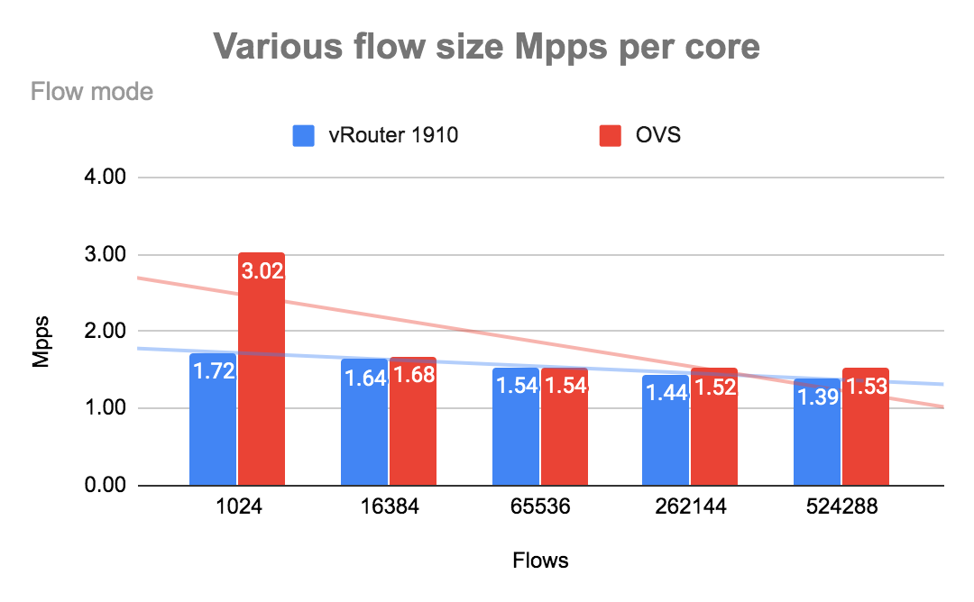
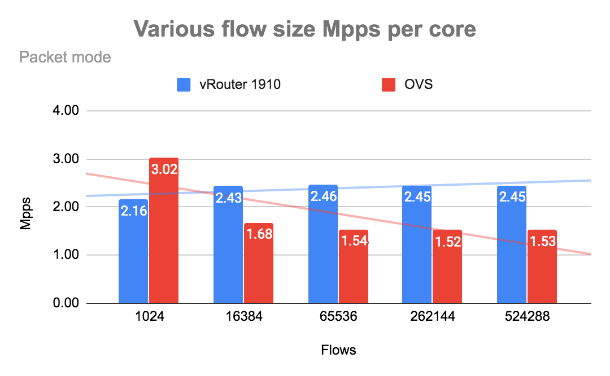
#2
Test various flow size

Slide 25
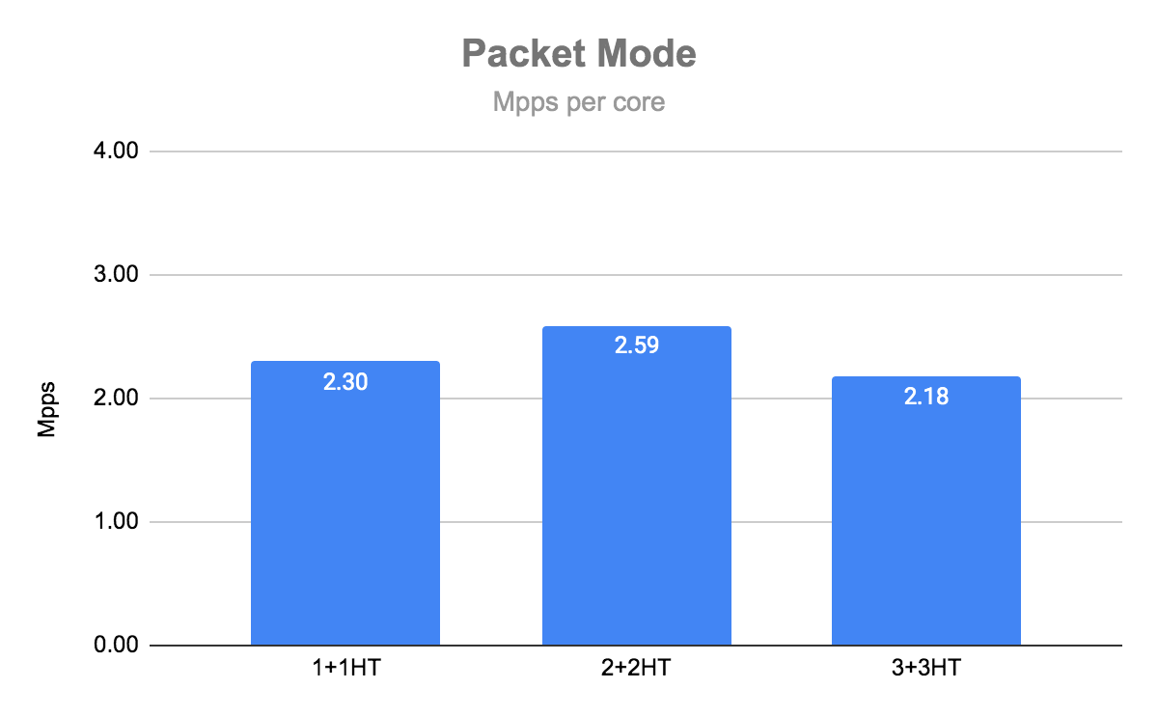

#3
Test various physical core number
Contrail 1910
Contrail 2003
*1024 Flows, 64 bytes packet size

Slide 26
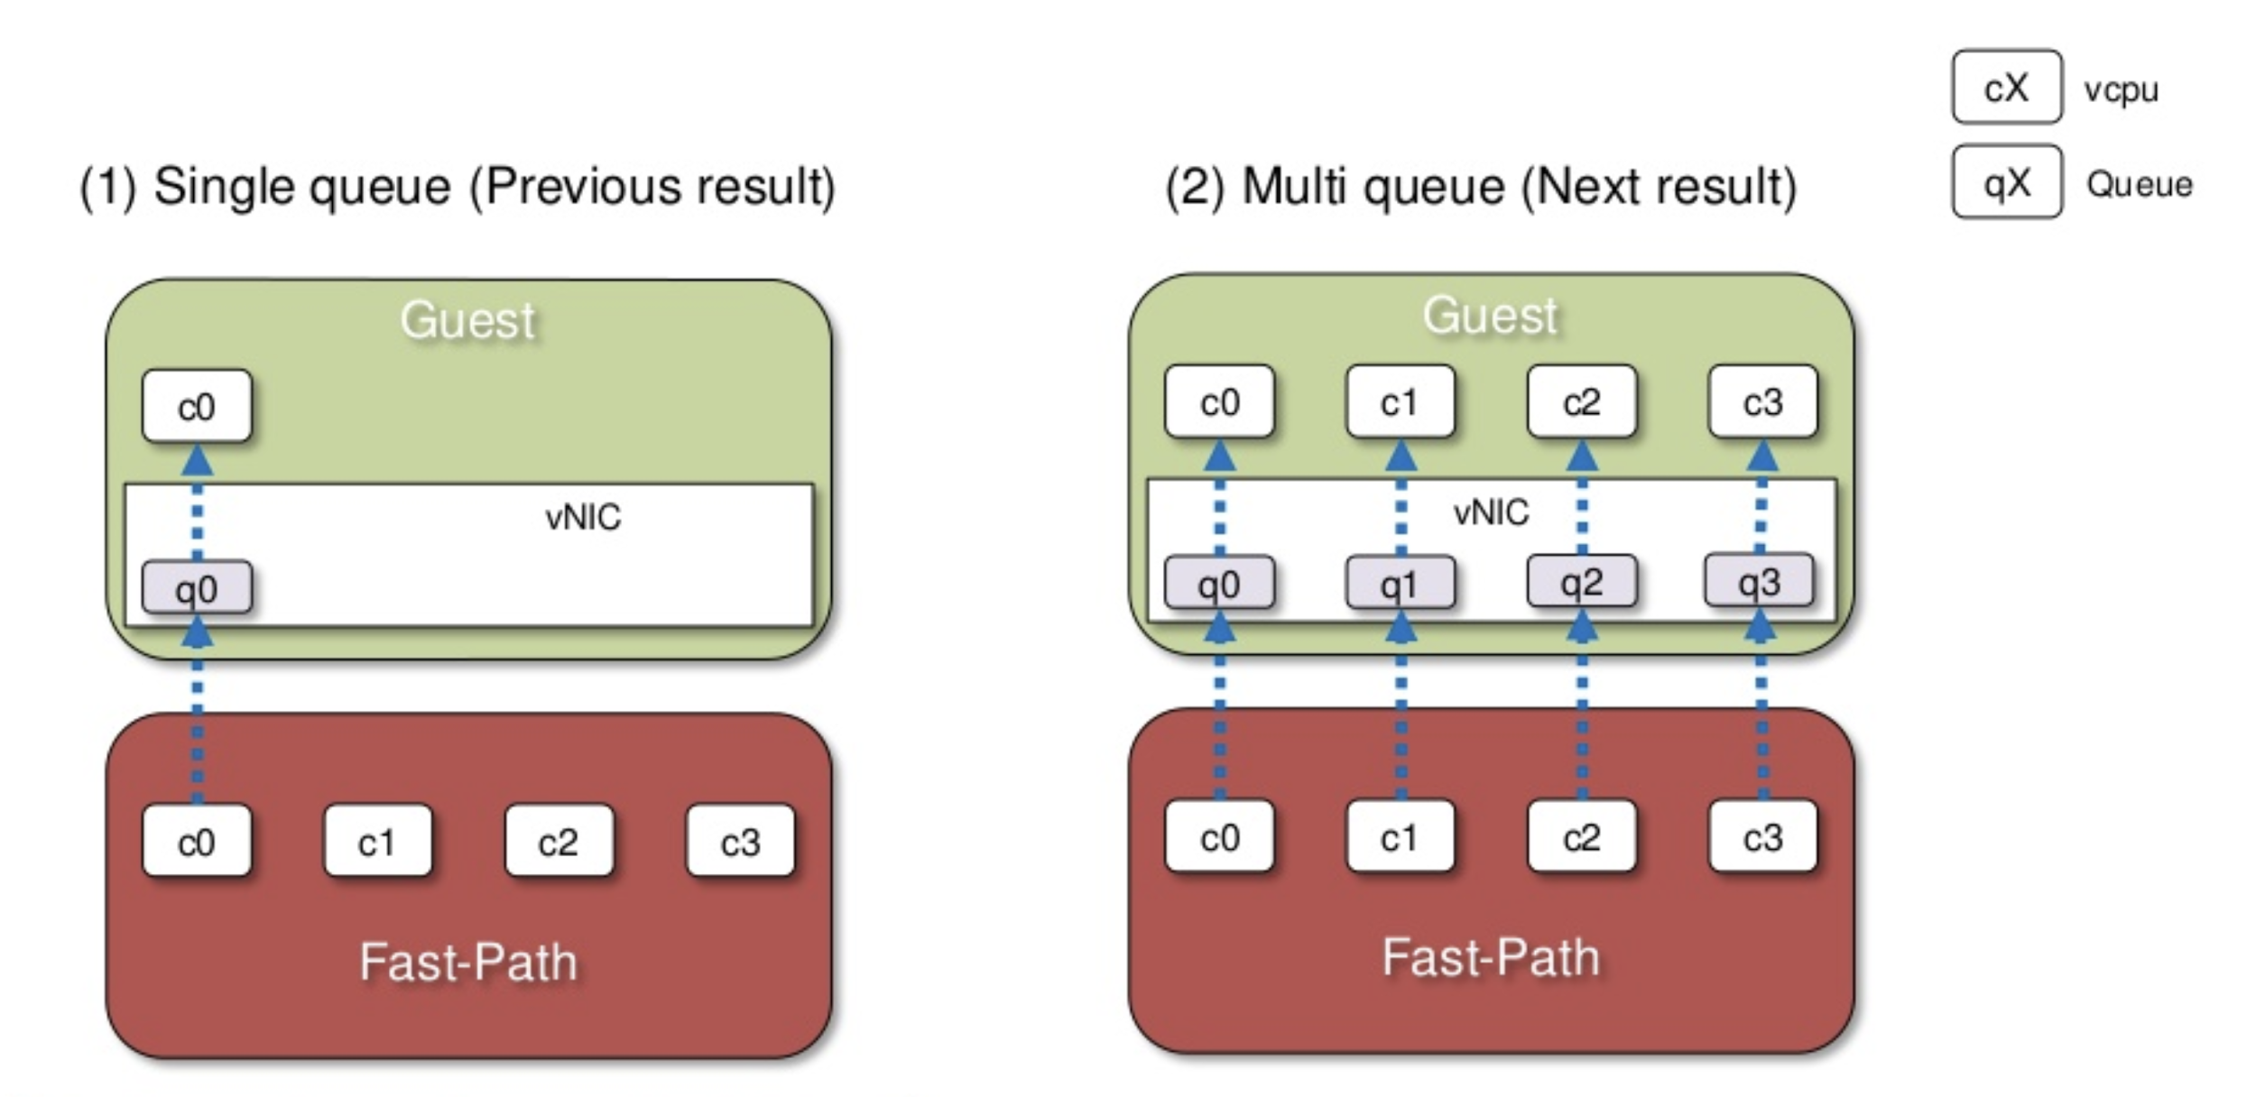
Single queue vs multi queue
OVS

Slide 27
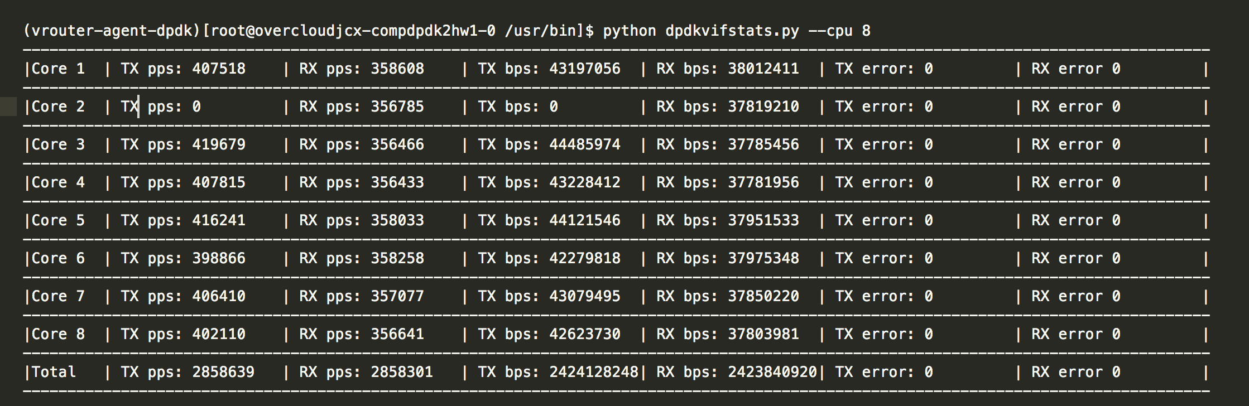
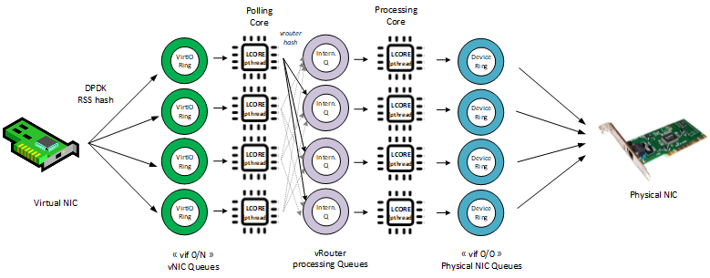
Single queue vs multi queue
vRouter

Slide 28
Queues/cores traffic ballance
OVS
manual rebalance or periodic (in traffic >70% can cause packet drops)
need to know VNF traffic characteristic to tune properly balancing
less dynamic (default every 60s checking PMD load and rebalance)
vRouter
balance is done automatically based on 5 tuple hash - require IP traffic with enough entropy
dropless rebalance

Slide 29
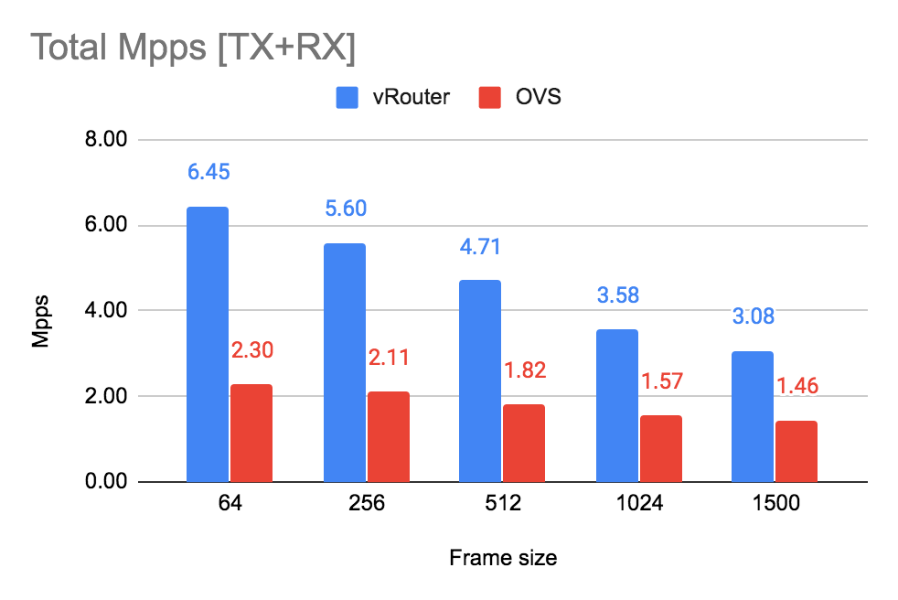
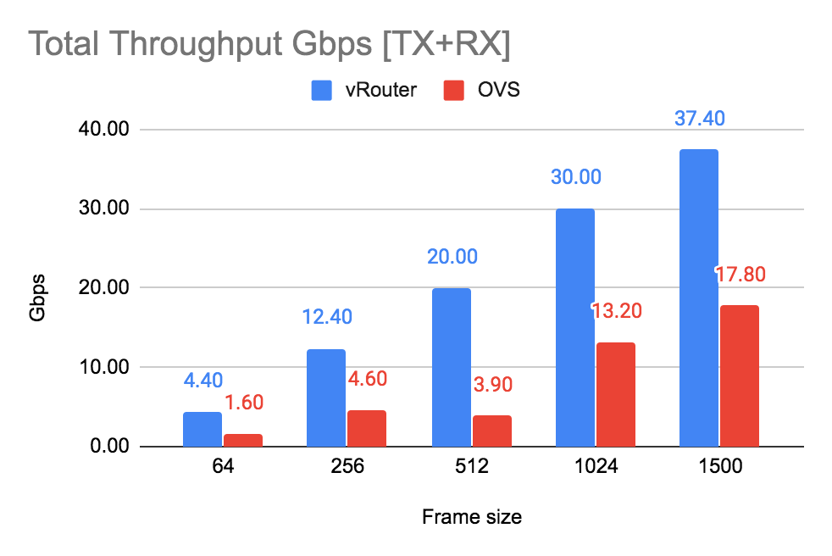
Non-multiqueue
vRouter vs OVS
OVS use only one queue/core and adding more cores do not increase speed
vRouter - additional intercore communication and balancing increase latency
*1910, 3 +3 HT, 16k Flows, 64 bytes packet size

Slide 30
Performance
AMD EPYC

Slide 31
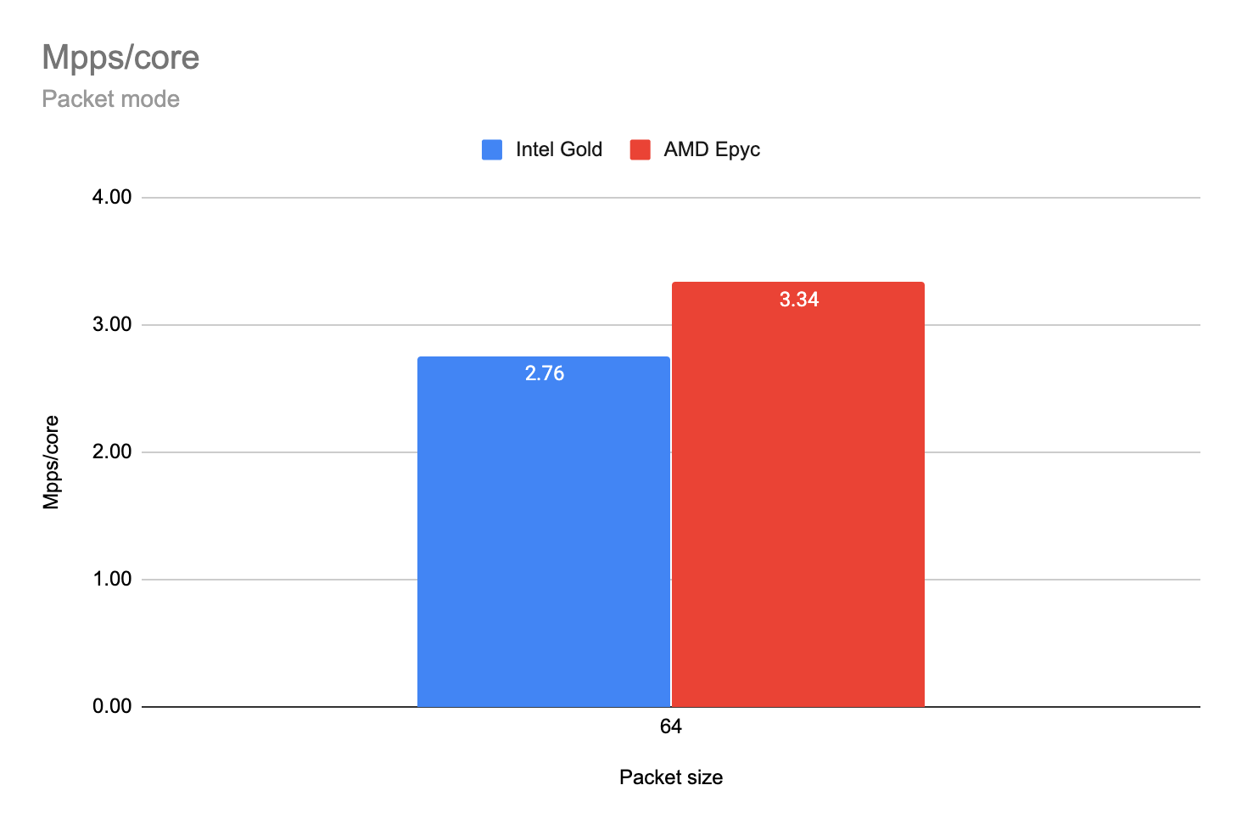
Intel vs AMD
Mpps per core AMD is 21% faster than Intel
Model name | Intel(R) Xeon(R) Gold 5120 CPU @ 2.20GHz
CPUs | 28
Sockets | 2
Physical Cores per Socket | 14
Threads per core | 2
Total logical cores | 56
Model name | AMD EPYC 7742 64-Core Processor
CPUs | 128
Sockets | 2
Physical Cores per Socket | 64
Threads per core | 2
Total logical cores | 256
*2003, 2 + 2 HT, 16k Flows, 64 bytes packet size

Slide 32
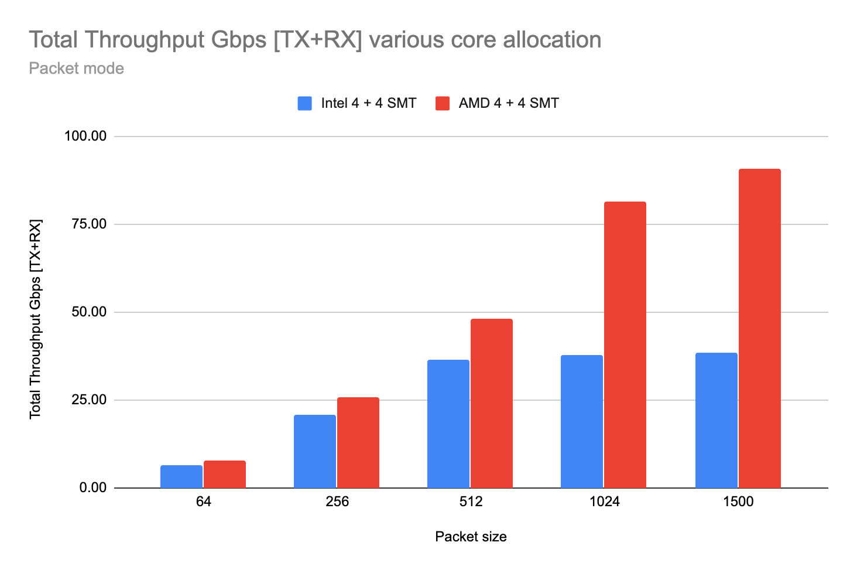
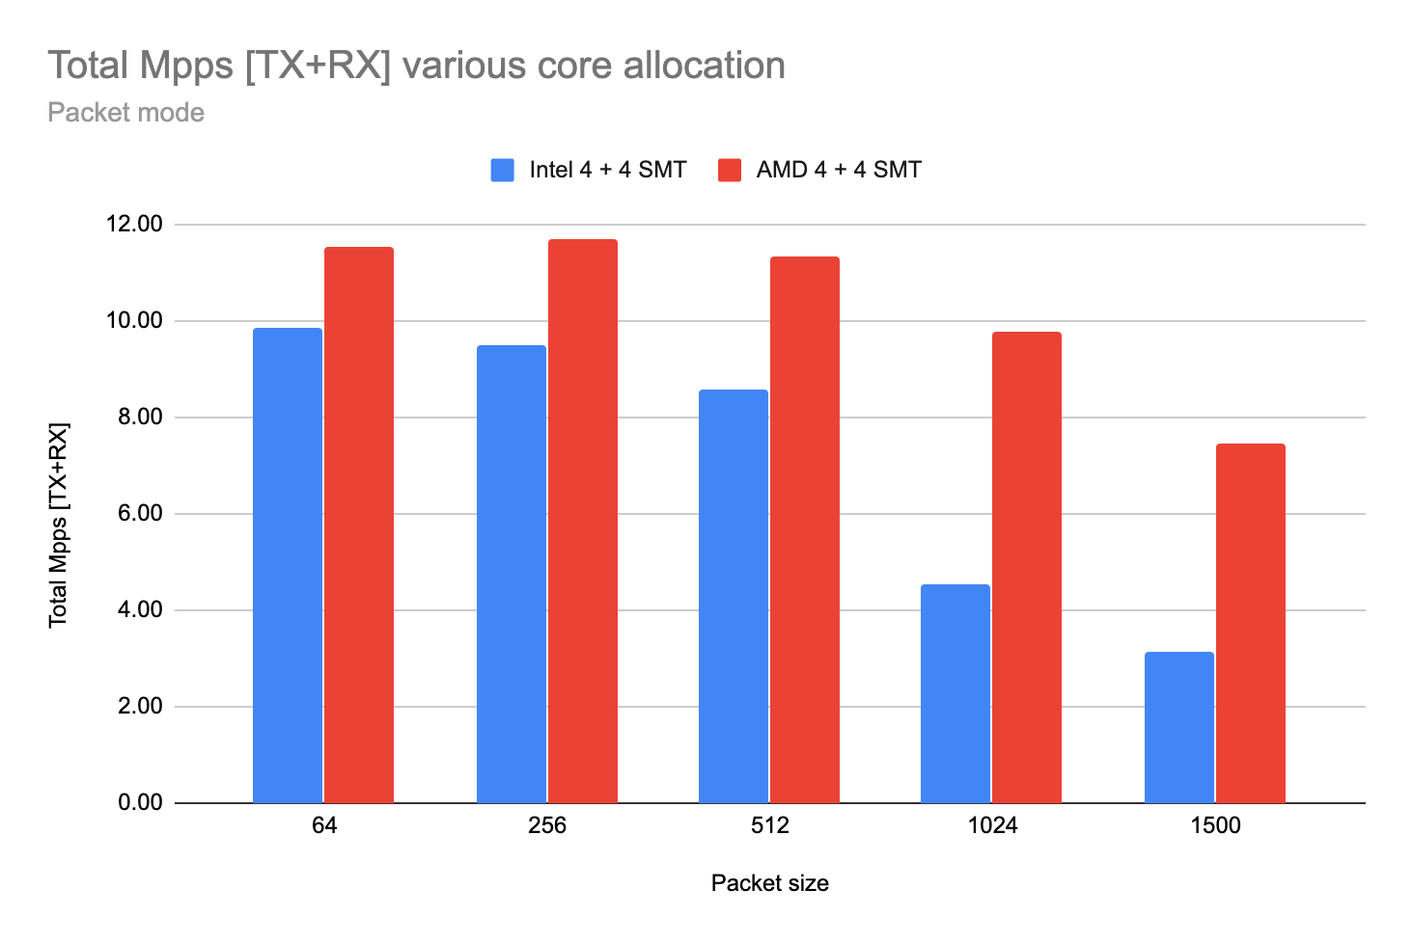
vRouter 4 physical cores use case
AMD can get up to 12 Mpps total (64B) on 4 physical cores, then 60 physical cores (120 logical with SMT) left for VMs and Operating system on the same NUMA.
With AMD no more problems with not enough cores for VNFs!!!
Intel can get up to 10 Mpps total (64B) on 4 physical cores, then ONLY 10 physical cores (20 logical with HT/SMT) left for VMs and Operating system on the same NUMA.

